Slide 1
Non-Traditional SAE Images
Instructions: Print off these images and place them around the room. Students will then label them as traditional or non-traditional SAE projects

Slide 2
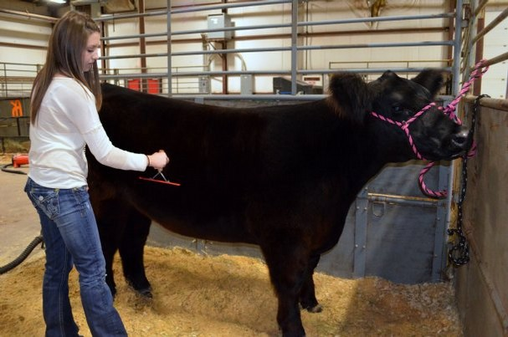

Slide 3
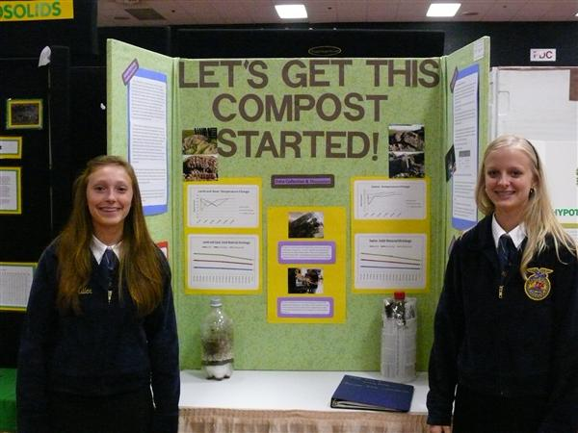

Slide 8
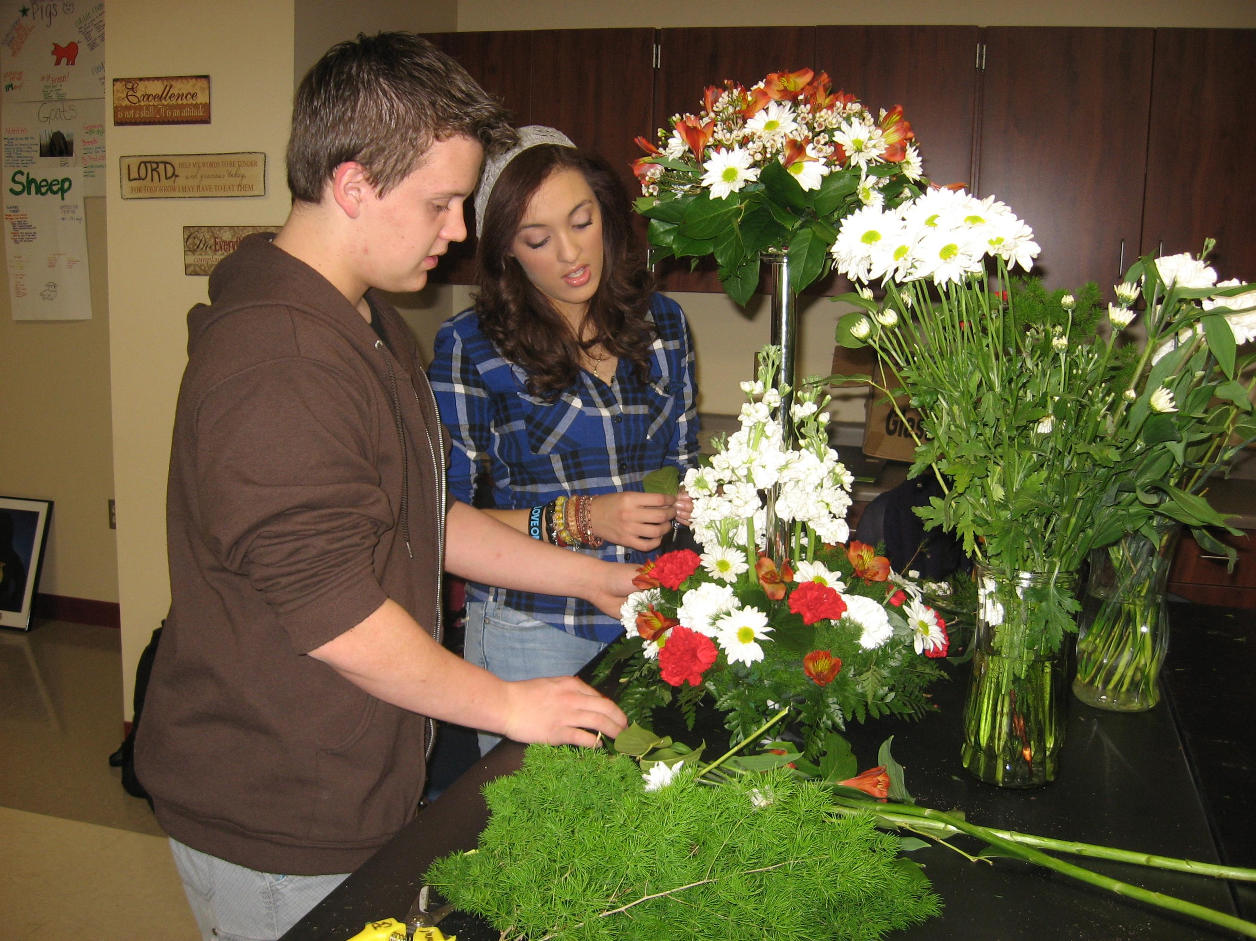

Slide 10
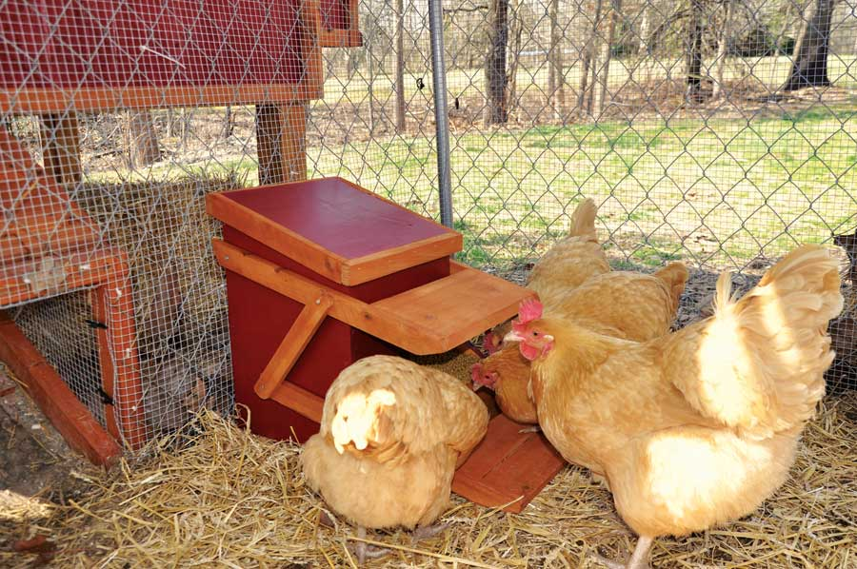

Slide 11
