Slide 1
Non-Traditional SAE
Developed by Department of Agricultural Leadership, Education &
Communications,
Texas A&M University
for the Texas Education Agency
Educational Excellence Project for AFNR
©Texas Education Agency, 2014

Slide 2
Objectives
Students will be able to describe an SAE project and the categories.
Students will be able to differentiate between traditional and non-traditional SAE projects.
Students will be able to create non-traditional SAE project ideas.

Slide 3
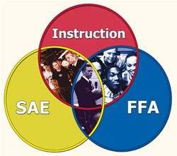
Vocabulary
Supervised Agricultural Experience- a practical application of classroom concepts designed to provide “real world” experiences and develop skills in agriculturally related career areas.

Slide 4
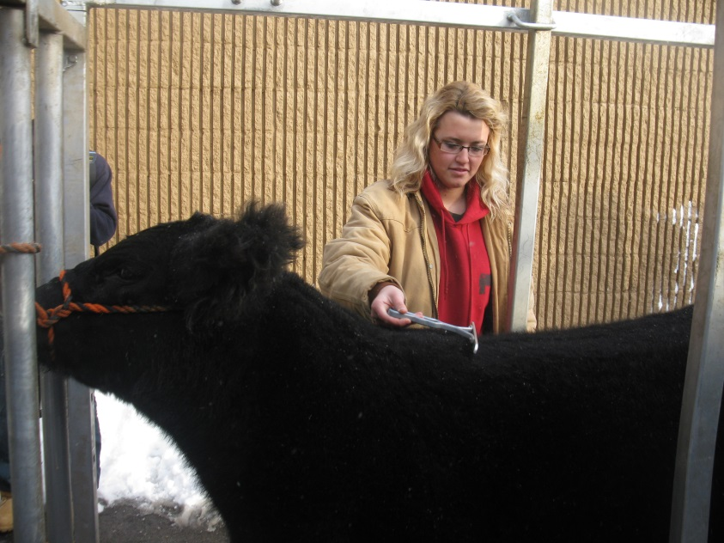
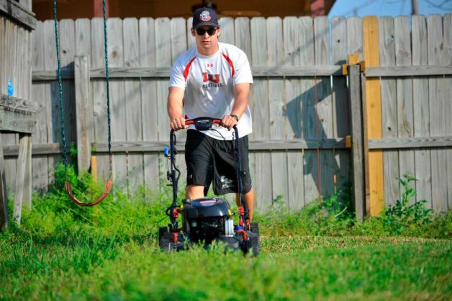
SAE Categories
Entrepreneurship SAE- you are the business owner. You plan and operate an agriculturally related enterprise or business.
Examples may include: owning livestock, managing a crop plot, managing a lawn mowing service.

Slide 5
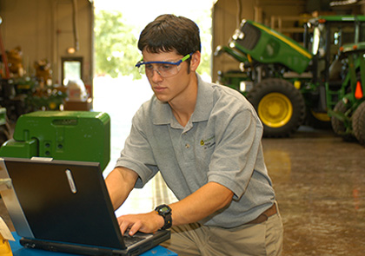
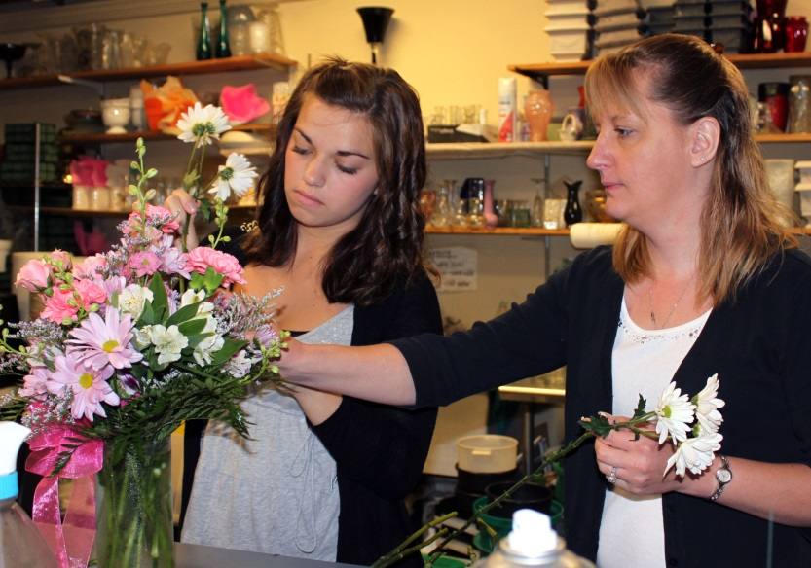
SAE Categories
Placement SAE- working for someone either for pay or experience.
Examples: working for a floral shop, being employed with a local equipment dealership, working for an elderly farmer.

Slide 6
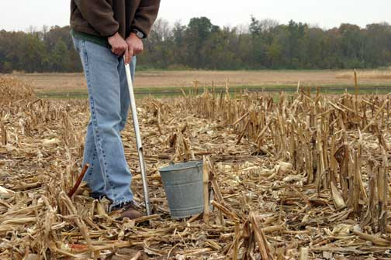
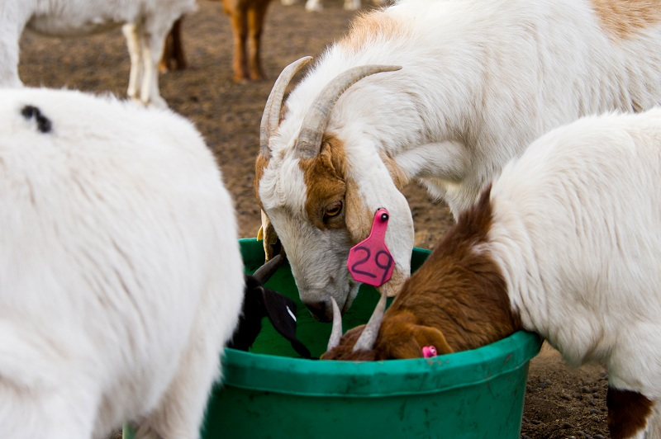
SAE Categories
Research SAE- an SAE where you conduct research using the scientific process.
Examples: Conducting plant and soil fertility tests, experimenting with different feed supplements in livestock, measuring antibiotic use and effects on meat quality.

Slide 7
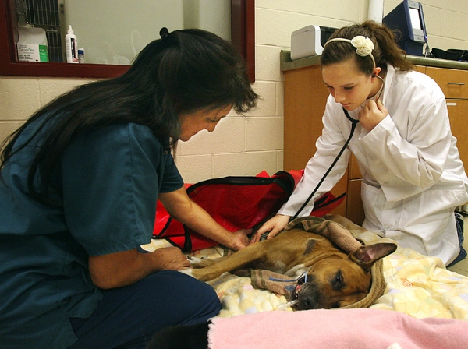
SAE Categories
Exploratory SAE- experiencing the “big picture” of agriculture and its many related careers.
Examples: attend a college visit at an agriculture college, job shadow a vet, develop a presentation on careers in the agronomy industry.

Slide 8
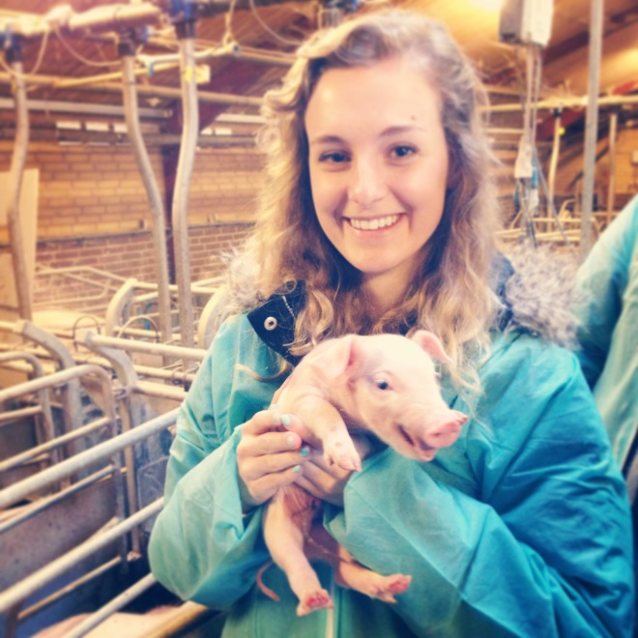
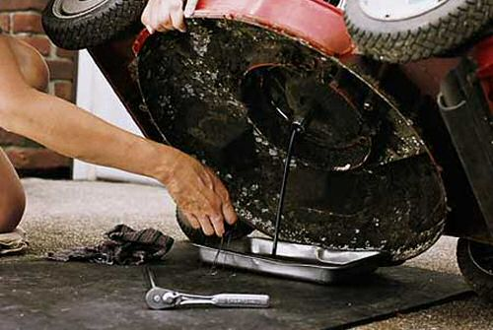
SAE Categories
Supplementary Activities- a specific skill learned outside the normal class time that contributes to the agriculture skills and knowledge obtained by the student.
Examples: learning to process piglets, changing the oil in a small engine, using GPS to plant deer food plots.

Slide 9
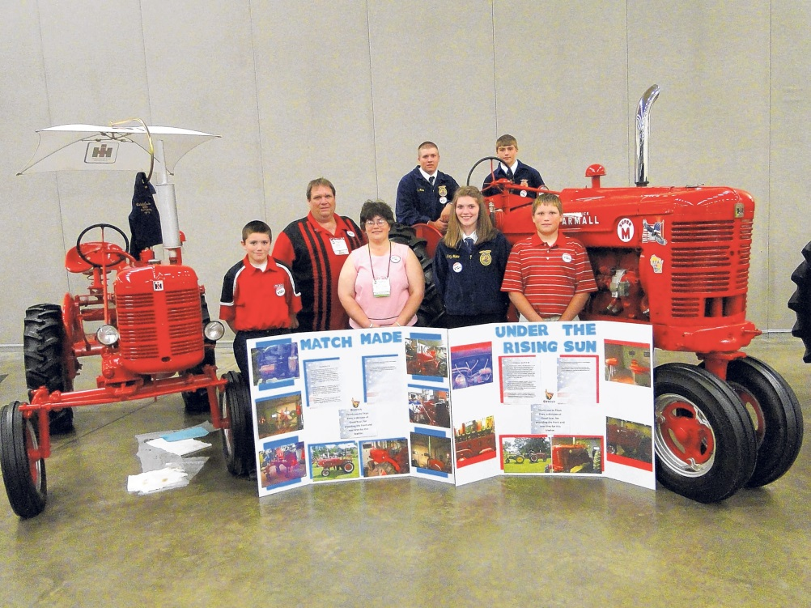
SAE Categories
Improvement SAE- a series of learning activities that improve efficiency, value, use or appearance of the place of employment, home, school or community.
Examples: restoring an antique tractor, cleaning a community park, repairing a fence.

Slide 10
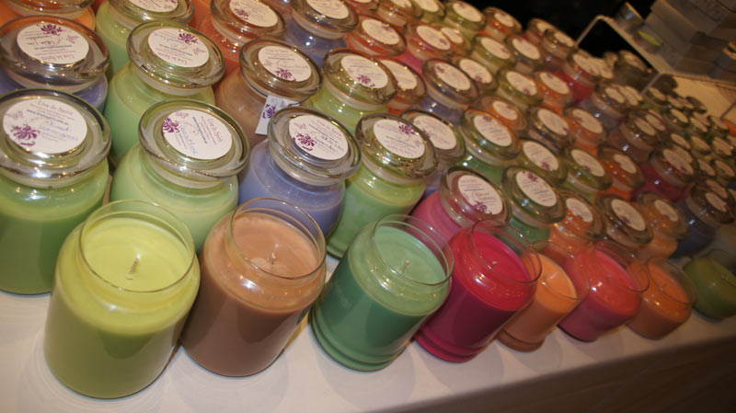
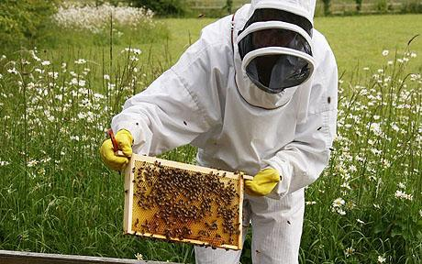
Non-Traditional SAE
Non-traditional SAE- SAEs outside of the normal scope of traditional agriculture.
Examples: conducting guided hunts, starting a community garden, making soy candles, raising bees for honey.

Slide 11
Activity
Break in to small groups of 3-5.
Create a description of a “non-traditional” agriculture student. After this, list 5 SAE projects that would be appropriate for this student.
Create a description of a “traditional” agriculture student with traditional SAE projects. List 5 non-traditional SAE activities that the student could do that related to his or her SAE project.

Slide 12
Questions?
References: Texas SAE Builder, ExploreSAE, National FFA Website (SAE), National FFA SAE PowerPoint.

